Slide 1
Module 5: Sampling
5.11: Respondent-driven sampling
Annie Collins
Data Sciences Institute, University of Toronto

Slide 2
Key Text
Salganik, M. J., & Heckathorn, D. D. (2004). 5. Sampling and Estimation in Hidden Populations Using Respondent-Driven Sampling. Sociological Methodology, 34(1), 193–240. https://doi.org/10.1111/j.0081-1750.2004.00152.x

Slide 3
Introduction

Slide 4
Introduction
What is respondent-driven sampling?
Researchers select a small number of individuals from the target population (“seeds”)
Seeds recruit other members of the target population from their own social networks
New sample members recruit additional sample members, and so on

Slide 5
Introduction
Why use respondent-driven sampling?
Small target population size, or difficulty distinguishing target population from general population
Example: amateur musicians or artists
An extremely large and expensive sample would be needed to find individuals of interest
Difficulty accessing target population members
Examples: people experiencing homelessness, drug users, illegal immigrants
Members may be difficult to access by typical survey means (mail, random digit dialing, etc.)
Members may be unwilling to self-identify
Sampling frame construction may be impossible due to lack of documentation

Slide 6
Existing Methods for Studying Hidden Populations

Slide 7
Existing Methods for Studying Hidden Populations
Targeted sampling
Researchers attempt to recruit members of the target population directly
Often involves locating a target population and accessing them directly in the field
May involve respondents in recruitment to some extent

Slide 8
Existing Methods for Studying Hidden Populations
Time-space sampling
A sampling frame is constructed based on times target population members gather in certain spaces
Time-space combinations are the primary sampling units
Members of the target population at selected times and venues are interviewed
Concerns: inaccessible venues, unsafe venues, non-representative samples (coverage bias), low sample yields with high cost

Slide 9
Respondent-Driven Sampling

Slide 10
Salganik and Heckathorn, 2004, Figure 1
Population
Population
Estimation
Social Network
Collection
Estimation
Collection
Sample
Sample
Estimation
Respondent-Driven Sampling
Traditional Sampling
Notes:
Bias might result from estimating directly from a sample to the whole population if the sample is collected through “chain referral” methods. Respondent-driven sampling aims to avoid bias by estimating about the social network first.

Slide 11
Sampling Procedure
Wave 0
Select s initial seeds based on existing connections with target population.
Each seed is interviewed/surveyed.
Each seed receives c unique recruitment coupons to give to others in the target population.
Seeds are incentivised both for participation and recruitment.
Wave 1
Individuals who received coupons from original seeds are interviewed/surveyed.
Each individual receives c new recruitment coupons.
Wave 1 individuals are incentivised both for participation and recruitment.
Waves 3,..., n
Recruitment and survey/interview process continues until desired sample size is reached.

Slide 12
Benefits of Respondent Recruitment
Researchers do not have to seek out target population members directly
Seeds do not have to identify their peers to researchers
Subsequent waves of participants self-identify and participate voluntarily

Slide 13
Considerations
Number of recruitment coupons (c)
Needs to be large enough that recruitment can continue even if some participants do not recruit anyone
Needs to be small enough that there will be multiple waves before sample size is reached
High number of waves is desirable – higher chance of accessing all parts of a social network, especially if seed selection is baised

Slide 14
Considerations
Duplication
Unique identification must be provided to ensure each individual only participates once
Non-traditional forms of identification may be preferable for hidden populations
Target population membership verification
Membership verification will be population/study specific

Slide 15
Data Collection
In addition to the data points collected in an interview/survey, it is also important to identify:
Self-reported respondent degree
How many additional population members is the respondent connected to?
Recruitment connections
If the respondent is not a seed, who recruited them?
Traced through unique recruitment coupons

Slide 16
Estimation

Slide 17
Assumptions
Sampling with replacement (population members can be recruited more than once)
Allows for constant population
Hidden population network forms one connected component
There is a series of relationships that connect any one person in the population to any other
All respondents receive and use one coupon
Seeds are drawn with a probability proportional to their degree
Can be shown that then each relationship has an equal probability of selection for recruitment, and individuals in waves 1 through n have selection probability proportional to their degree as well

Slide 18
Salganik and Heckathorn, 2004, Figure 2
A Social Network
and represent two different types of people.
Dotted lines represent relationships between people of the same group.
Solid lines represent relationships between members of different groups.
Notes:
NOTE: These diagrams represent the same network represented two distinct ways

Slide 19
Salganik and Heckathorn, 2004, Figure 2
Denote the group of all circles as group A, the group of all diamonds as group B, and the highlighted circle as circle i.
Let d_{i} represent the degree of person i, meaning number of relationships that involve person i.
Here, d_{i} = 4.

Slide 20
Salganik and Heckathorn, 2004, Figure 2
Let n_{A} represent the number of individuals sampled from from group A and n_{B} represent the number of individuals sampled from from group B.
If the orange shapes represent sampled individuals, n_{A} = 2 and n_{B} = 1.

Slide 21
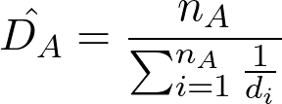
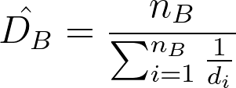
Estimating D_{A} and D_{B}
Let D_{i} be the average degree of members of group i.
D_{A} and D_{B} can be estimated as follows:
D_{A} and D_{B} are asymptotically unbiased.

Slide 22
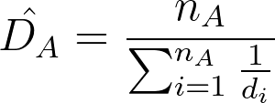
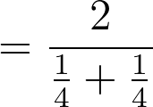

Salganik and Heckathorn, 2004, Figure 2

Slide 23

Salganik and Heckathorn, 2004, Figure 2

Slide 24
Salganik and Heckathorn, 2004, Figure 2
Let r_{ij} represent the total number of recruitments from sampled members of group i to members of group j.
For example, suppose the purple lines represent recruitments from sampled individuals.
Then,
r_{AB} = 1 ( → )
r_{AA} = 3 ( → )
r_{BA} = 1 ( → )
r_{BB} = 2 ( → )

Slide 25


Estimating C_{A,B} and C_{B,A}
Let C_{A,B} be the probability that if we start with a random individual in group A and follow a randomly chosen relationship from this individual, we end up finding an individual in group B (C_{B,A} is thus the opposite).
C_{A,B} and C_{B,A} can be estimated,
C_{A,B} and C_{B,A} are unbiased.

Slide 26
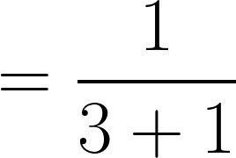
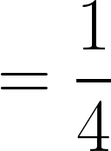
Salganik and Heckathorn, 2004, Figure 2
For this network,

Slide 27
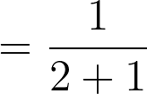

Salganik and Heckathorn, 2004, Figure 2
For this network,

Slide 28
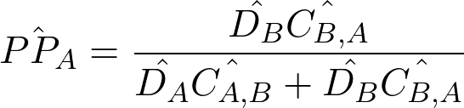

Estimating PP_{A} and PP_{B}
An unbiased estimator for the population proportion of group A is,

Slide 29
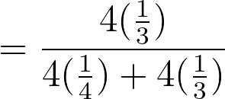



Salganik and Heckathorn, 2004, Figure 2
(True PP_{A} is 0.6)
(True PP_{B} is 0.4)

Slide 30
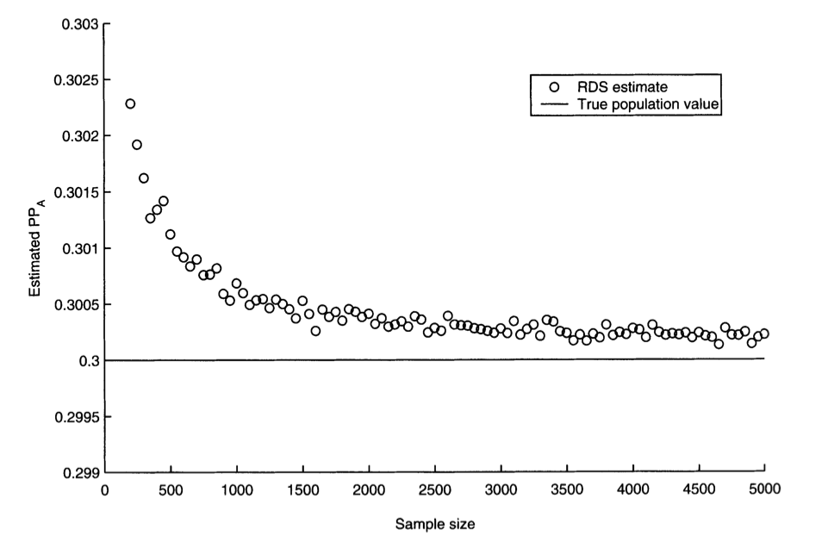
Salganik and Heckathorn, 2004, Figure 7
Notes:
FROM TEXT: simulation results for a population with 30 percent of its members in group A, and where the seeds are drawn with probability proportional to degree squared. Note that even for small sample sizes of fewer than 200 people, the average estimate has a small bias-a little more than two-tenths of one percentage point (0.002). As the sample size gets larger, the bias gets smaller. In this case, for a sample size of 500 the bias is about one-tenth of one percentage point (0.001), or well within rounding error and not a serious cause for concern.

Slide 31
Next
5.12 More advanced topics related to collecting data

